Slide 1
Autonomous Crowd-crossing Navigation with Hybrid Path Planning
Presented by: Zhenya Guo, Kian Ming Phua, Yu Song, Yi Jie Tan, Peizhang Zhu

Slide 2
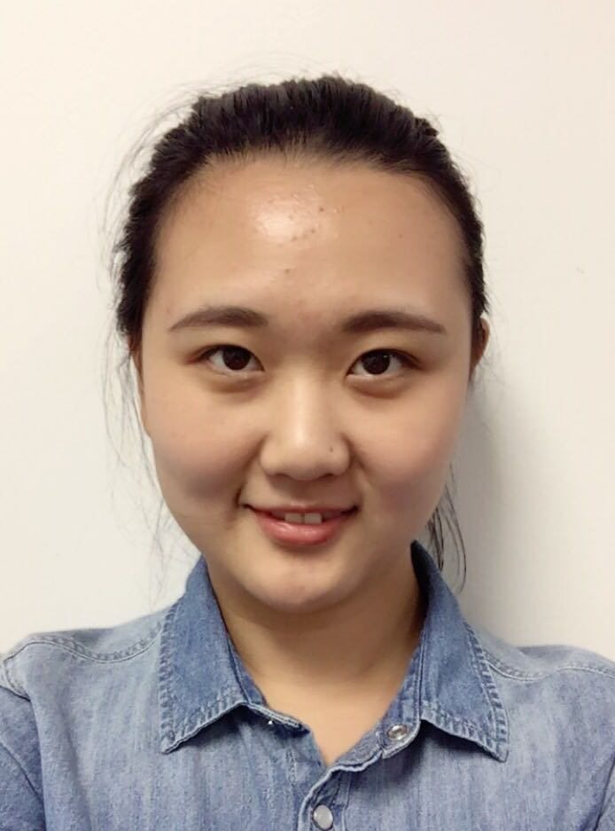
Background
Huge market space in courier & delivery service industry.
Industry limited by volatile fuel price and rising labor costs.
Notes:
The revenue of global delivery service industry is about 250 billion dollars this year. The growth of the industry is limited by the volatile fuel price and rising labor costs. The market space is left for automation to enhance energy saving and replace human labor.

Slide 3
Project Intro
Followed work in paper Socially Aware Motion Planning with Deep Reinforcement Learning
MPC controller on a 2-D vehicle model
Obstacle avoidance vs. Optimized path planning
Notes:
As MIT researchers have proved the possibility of autonomous driving for delivery robot in pedestrian-rich environment. Our project will follow the work and apply the MPC controller on a 2-D vehicle model. Different from other type autonomous driving, delivery robot cares more about safety issue. So besides the optimized path planning, the project will also emphasize the obstacle avoidance.

Slide 4
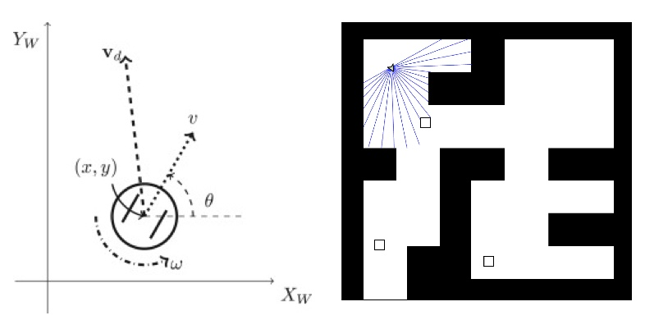

Model of Autonomous Robot
Robot Pose in a 2D X-Y Plane
x , y - Position (m)
θ - Orientation (rad)
v - Velocity (m/s)
Control Input for Robot
v_{d} - Linear Velocity (m/s)
ω - Angular Velocity (rad/s)
Achieved with Pure Pursuit controller

Slide 5
2D Map Used to Simulate Actual Crowded Environment
Convert image into 2D Binary Occupancy Grid
Static Obstacles - Walls
Black areas
Regions free for traversal
White areas
Dynamic Obstacles - Humans
Black square boxes
Movement of “humans” along a linear path in the free space

Slide 6
Forward Pose Light Detection and Ranging (LIDAR) for Obstacle Detection
Use of LIDAR for obstacle detection (static, dynamic)
Forward Pose LIDAR with π radians field of view
Only aware of obstacles within the radius of the laser
Obstacles beyond the radius are not relevant in the control computation phase for obstacle avoidance

Slide 7

Pure MPC Has Limitations
Shortsighted
Unable to consider the map as a whole
Discontinuous
Runs before each drive step, and requires strong computational support to be fast enough

Slide 8
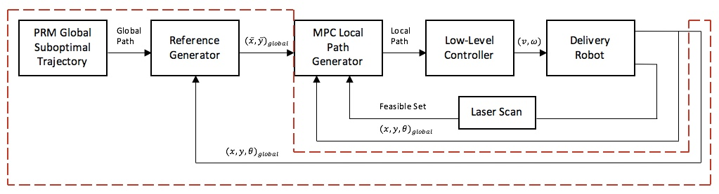
Optimized Probabilistic Roadmap: The Global Planner

Slide 9
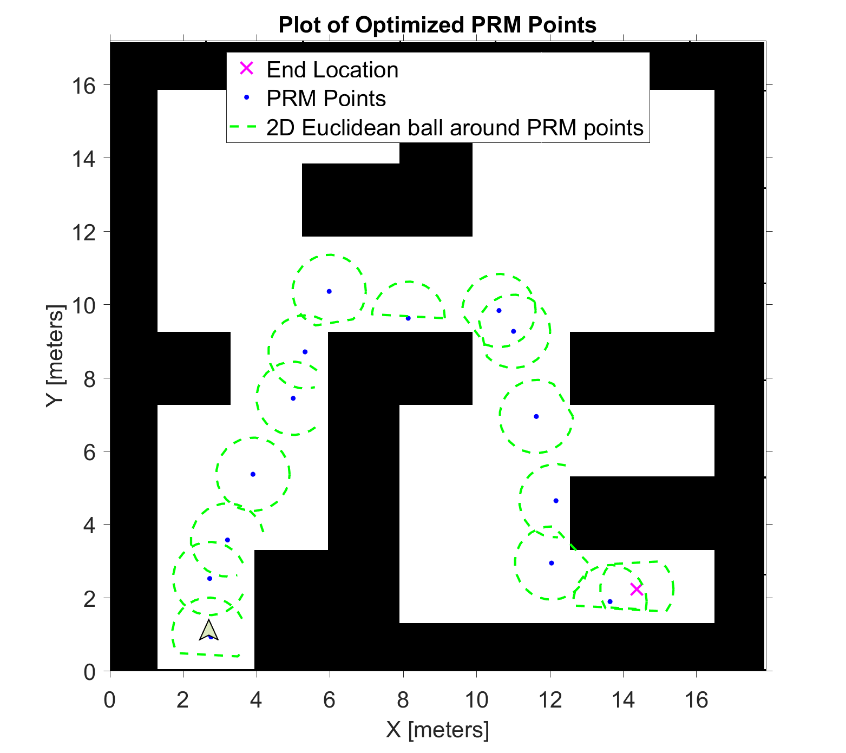
Optimized Probabilistic Roadmap: The Global Planner
Generate basic probabilistic roadmap waypoints
Create 2d euclidean balls around these waypoints

Slide 10
Reference Generator: Choose Targets for MPC

Slide 11
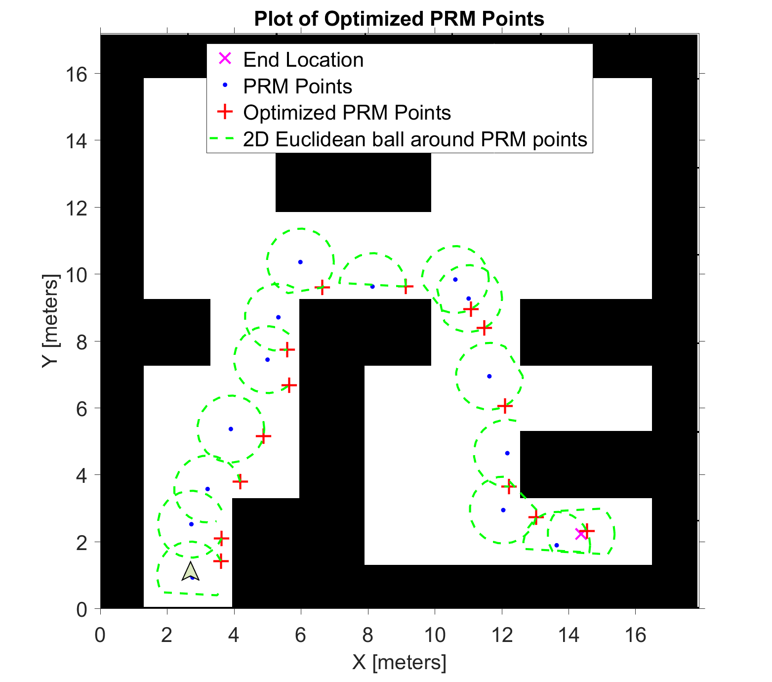
Reference Generator: Choose Targets for MPC
Create optimized PRM points on the 2d euclidean balls
Select one of the points as the current reference for MPC; change the reference as the car moves

Slide 12
MPC: The Short-Range Navigator

Slide 13
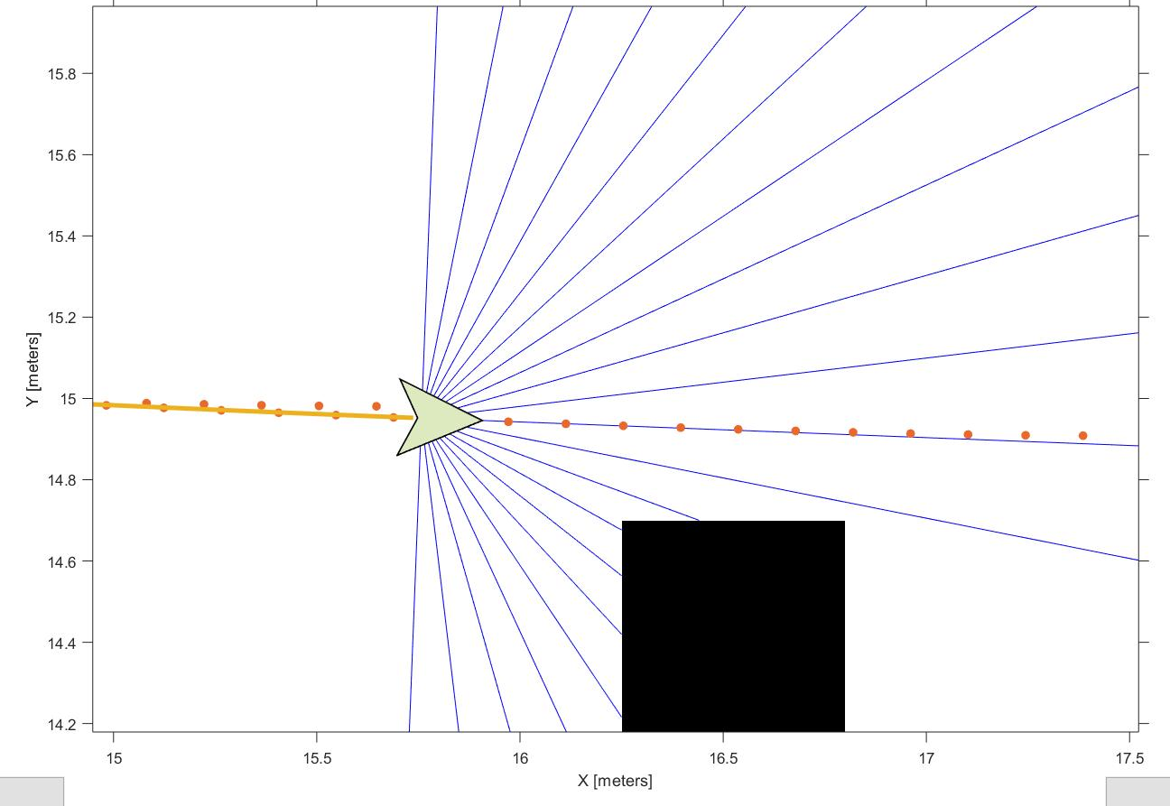
MPC: The Short-Range Navigator
Consider the current reference point and the obstacle’s position
Run optimization and get a 2 by 20 vector of optimal coordinates that the car should follow
Feed it to a lower-level position tracking controller

Slide 14
Position Tracking Controller: Execute MPC’s Result
Take the coordinate from the 10th time step of the optimal vector as the target of current driving operation

Slide 15
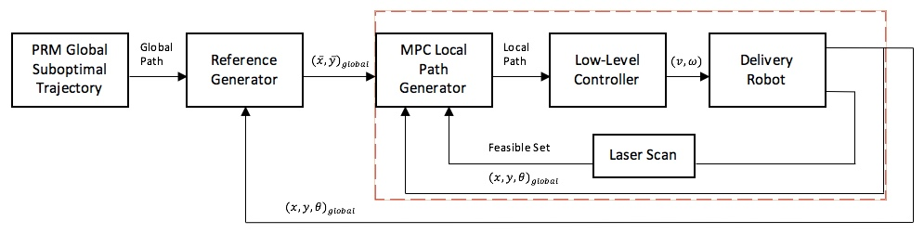

MPC Local Path Planner with Obstacle Avoidance
Use sensor data to create a feasible region for MPC
Find an optimal obstacle-free local path to track the reference point
Responsible to drive the delivery robot to follow the local path
Send the current states to each generators
Notes:
This is the MPC control loop diagram
The inner-loop control system consists of four block : MPC Local Path Generator, Low-Level Controller, Delivery Robot and Laser Scan. The Laser Scan, using sensor data, would provides MPC a feasible region. MPC is used to find the optimal feasible local path to track the reference point. And the Low-Level Controller is responsible to drive the delivery robot to follow the local path. At the same time, the Delivery Robot would send the current states to each generators.

Slide 16
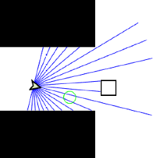
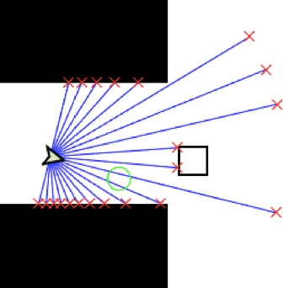
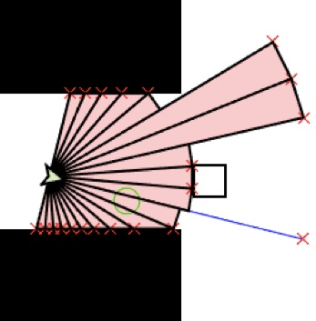
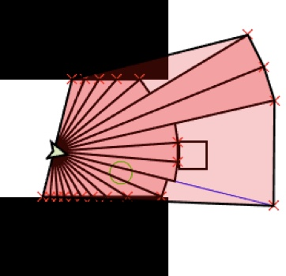
Construction of Feasible Region and Convex Set
Laser Beams
Position of Obstacles
Feasible Region
Convex Set
Notes:
The data from the laser scan would be the range of the laser beam and its local position angle. Our method is to use these data to construct a feasible region by using the Matlab function - polyhedron(). This function would automatically construct the polyhedron. This polydedron is our feasible region.The biggest problem of the feasible region is that the region is not a convex set which will lead the MPC to get a local other than global optimum path to track the reference points and even sometimes it fail to find one. To address this problem, we introduce a new method to solve it. The solution to this problem we introduced is to make the feasible region into a minimum convex set by matlab function, as showed in the picture. This will ensure the MPC path planner always has a global optimal solution to the optimal control problem. And since the path is alway from feasible region to infeasible one. We could only take the continuous path that is in the feasible region.

Slide 17
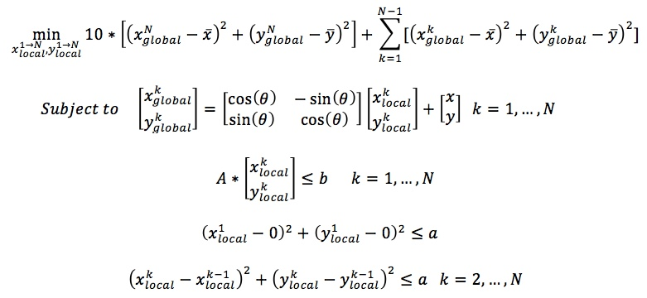
Implemented Algorithm
Stage Cost
Terminal Cost
Coordinate Transformation
Convex Set
Continue Path Approximation
Notes:
For MPC algorithm, the cost function is consist of stage cost and terminal cost. Both of them are used to pernalize the distance to reference point.
Next is coordinate transformation from local frame to global frame. Since we get the robot’s postion (x,y,theta) at any time, the transform matrix could be easily computed out.
As for the Convex set, the matrix A, b could be retrieved directly from Matlab function polyhedron().H. This inequlity would keep the path always lie in the convex set that we constrcuted.
The last two inequalities are the continue path approximation. They are used to ensure the path approximately continuous and starts at original point in the local coordinate system. ‘a’ coeffection could be defined as any small enough number. In our project, we set a is equal to power of 5 centimeters.
For each MPC iterations, we only choose half path as our controller’s waypoints to reduce the computation time and strengthen the ability to resist uncertainty.

Slide 18
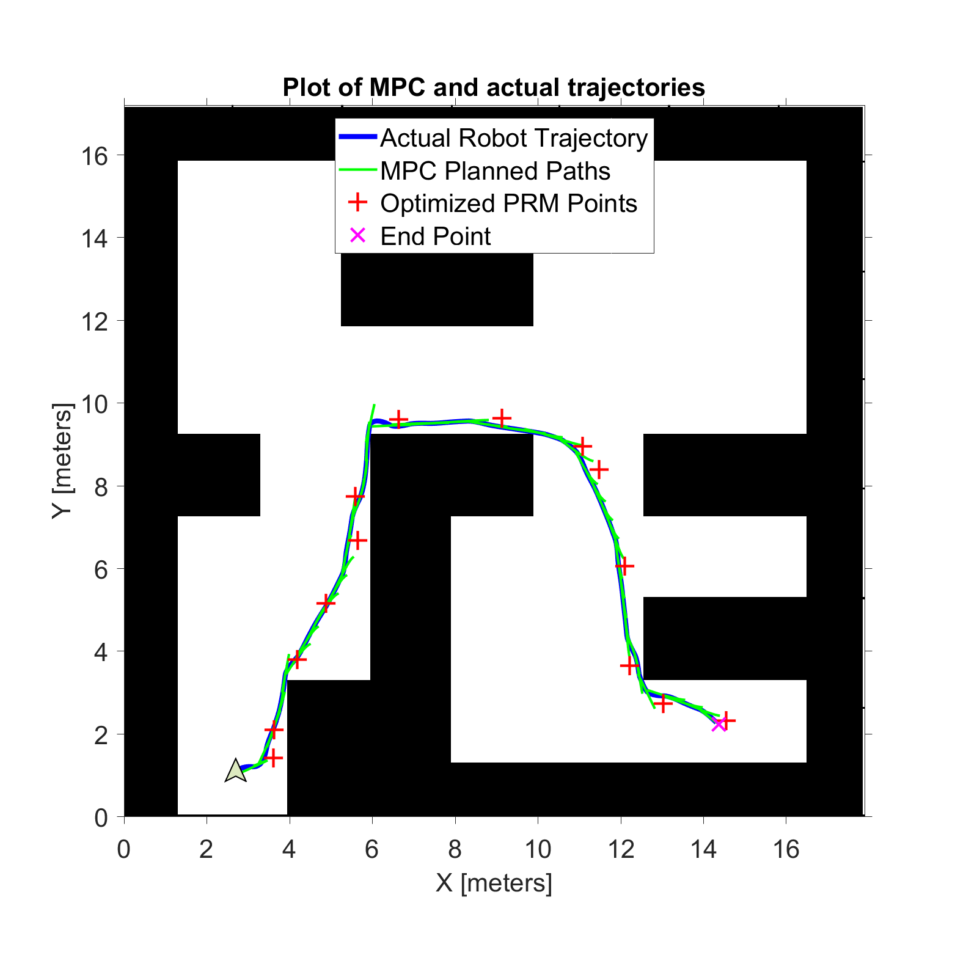

Results

Slide 19
Discussion
MPC controller takes about 3 seconds at every step
Can be problematic if implemented on a real-time system
Reduce computation time by using a more direct numerical method

Slide 20
Future work
Two areas for development: model implementation and random movement of dynamic obstacles
Instead of using a unicycle model, a more accurate 2D car kinematic model can be used
More human obstacles with random movement can be added to the map

